Slide 1
Basics of Electronics Engineering
(BEE-EC101)
Introduction to Internet of Things
Batch-2020
CSE
By: Harpreet Kaur

Slide 2
Outline
Definition of IoT
Characteristics of IoT
Physical design of IoT
Logical design of IoT
Book website: http://www.internet-of-things-book.com
Bahga & Madisetti, © 2015

Slide 3
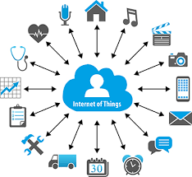
IoT
https://www.youtube.com/watch?v=GIfWNtMfYvk&t=1s
https://www.youtube.com/watch?v=Q3ur8wzzhBU

Slide 4
IoT
Internet Of Things is Fully Networked and Connected Devices sending analytics data back to cloud or data center.
The definition of Internet of things is that it is the network in which every object or thing is provided unique identifier and data is transferred through a network without any verbal communication.
Scope of IoT is not just limited to just connecting things to the internet, but it allows these things to communicate and exchange data, process them as well as control them while executing applications.

Slide 5
Formal Definition of IoT
A dynamic global network infrastructure with self- configuring capabilities based on standard and interoperable communication protocols, where physical and virtual “things” have identities, physical attributes, and use intelligent interfaces, and are seamlessly integrated into information network that communicate data with users and environments.

Slide 6
Characteristics of IoT
Dynamic Global network & Self-Adapting : Adapt the changes w.r.t changing contexts
Self Configuring : Eg. Fetching latest s/w updates without manual intervention.
Interoperable Communication Protocols : Communicate through various protocols
Unique Identity : Such as Unique IP Address or a URI
Integrated into Information Network : This allows to communicate and exchange data with other devices to perform certain analysis.

Slide 7
Physical Design of IoT
Things in IoT
IoT Protocols

Slide 8
Things in IoT
Refers to IoT devices which have unique identities that can perform sensing, actuating and monitoring capabilities.
IoT devices can exchange data with other connected devices or collect data from other devices and process the data either locally or send the data to centralized servers or cloud – based application back-ends for processing the data.

Slide 9
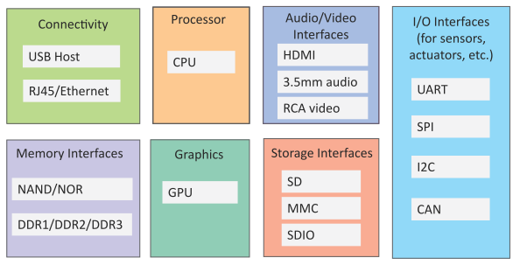
Generic Block Diagram of an IoT Device
An IoT device may consist of several interfaces for connections to other devices, both wired and wireless.
I/O interfaces for sensors
Interfaces for internet connectivity
Memory and storage interfaces
Audio/video interfaces

Slide 10
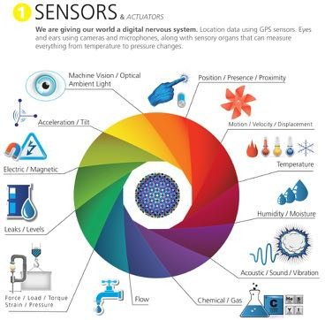
Sensors

Slide 11
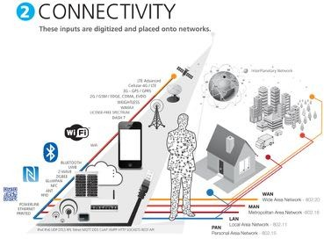
Connectivity

Slide 12
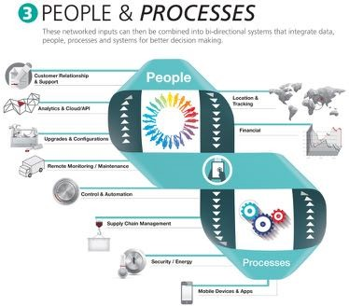
People and Processes

Slide 13
Four fundamental components
Here, are four fundamental components of an IoT system:
1) Sensors/Devices: Sensors or devices are a key component that helps you to collect live data from the surrounding environment. All this data may have various levels of complexities. It could be a simple temperature monitoring sensor, or it may be in the form of the video feed.
A device may have various types of sensors which performs multiple tasks apart from sensing. Example, A mobile phone is a device which has multiple sensors like GPS, camera but your smartphone is not able to sense these things.

Slide 14
2) Connectivity: All the collected data is sent to a cloud infrastructure. The sensors should be connected to the cloud using various mediums of communications. These communication mediums include mobile or satellite networks, Bluetooth, WI-FI, WAN, etc.

Slide 15
3) Data Processing: Once that data is collected, and it gets to the cloud, the software performs processing on the gathered data. This process can be just checking the temperature, reading on devices like AC or heaters. However, it can sometimes also be very complex like identifying objects, using computer vision on video.

Slide 16
4)User Interface: The information needs to be available to the end-user in some way which can be achieved by triggering alarms on their phones or sending them notification through email or text message. The user sometimes might need an interface which actively checks their IOT system. For example, the user has a camera installed in his home. He wants to access video recording and all the feeds with the help of a web server.

Slide 17
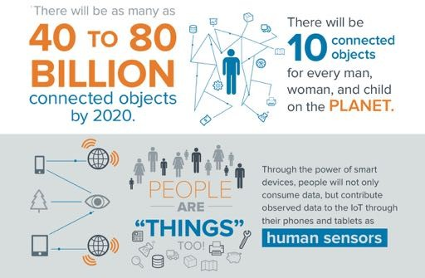
IoT

Slide 18
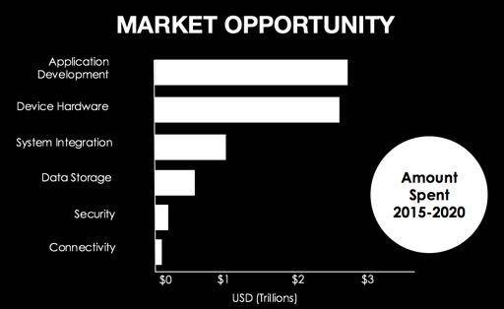
HOW BIG IS THE IOT MARKET?
By 2016 Gartner predicts 6.4 billion devices will be connected to the internet -- and 5.5 million new 'things' will join them each day.
new 'things' will join them each day.

Slide 19
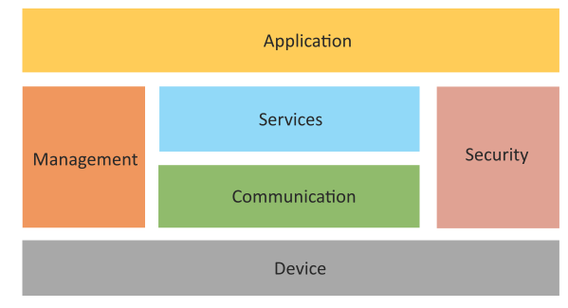
Logical Design of IoT
Logical design of an IoT system refers to an abstract representation of the entities and processes without going into the low-level specifics of the implementation.
An IoT system comprises a number of functional blocks that provide the system the capabilities for identification, sensing, actuation, communication and management.
Book website: http://www.internet-of-things-book.com

Slide 20
Logical Design of IoT
Device : Devices such as sensing, actuation, monitoring and control functions.
Communication : IoT Protocols
Services like device monitoring, device control services, data publishing services and device discovery
Management : Functions to govern the system
Security : Functions as authentication, authorization, message and content integrity, and data security
Applications
Book website: http://www.internet-of-things-book.com
Bahga & Madisetti, © 2015

